Slide 1
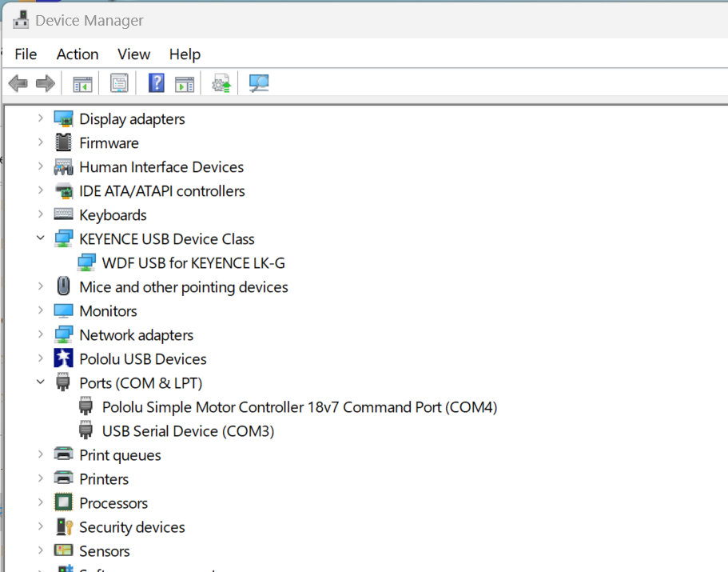
Maker sure USB hub power is ON Then
In Device Manager, make sure you have
Keyance LK-G
Pololu MC 18v7 (COMX)
USB Ser Device (COMY) -- DataQ

